Slide 1

k-Nearest Neighboor
Dr. Retno Kusumaningrum, S.Si., M.Kom.
Notes:
Alasan Libur 2 Minggu Pertama
3 Investasi Utama Hidup

Slide 2
Characteristics & Definition
k-NN

Slide 3
What are The Differences?
Lazy Learning
Eager Learning

Slide 4
The Differences
Lazy Learning
On querying similarity between testing data and training data (which are stored in database) is calculated to predict the class of testing data
Eager Learning
Generalized model is generated from training data
Subsequently, using the model to predict the testing data

Slide 5
Characteristics
Is a type of Instance Based Learning / Lazy Learning
Computation is delayed until classification
Simplest technique since there is no prior knowledge about the distribution of the data

Slide 6
Intuition
k-NN

Slide 7
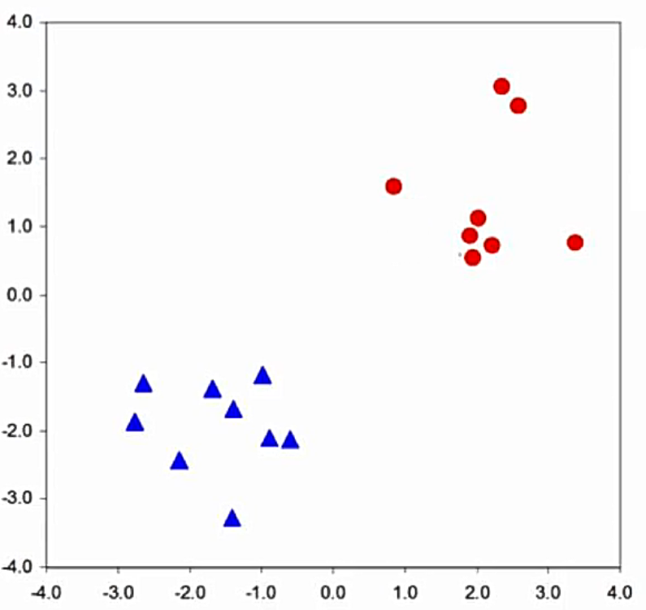

Example
Set of points $(x_{1},x_{2})$ :
The data consist of two features, i.e. $x_{1}$ and $x_{2}$
There are two classes, i.e. Red (Circle) or Blue (Triangle)

Slide 8
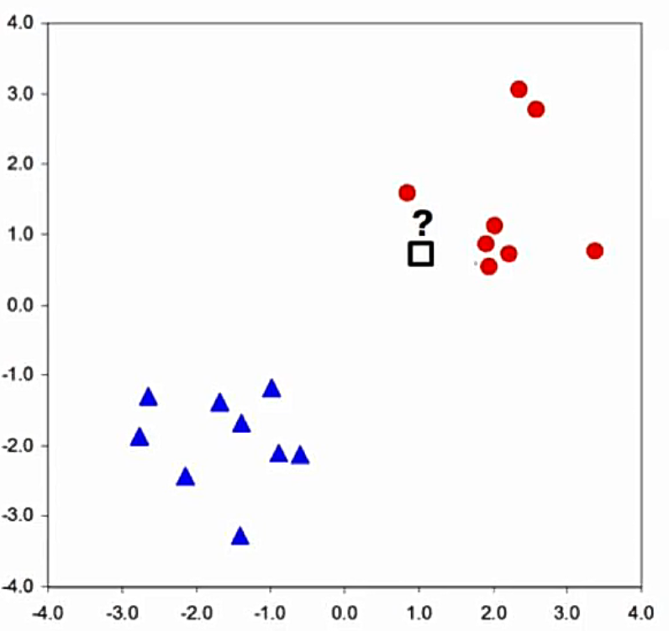
Example
What is the box class? Is it red or blue?
Nearby point is red
We can use this as a basis of learning algorithm

Slide 9
Nearest Neighboor Classification
k-NN

Slide 10
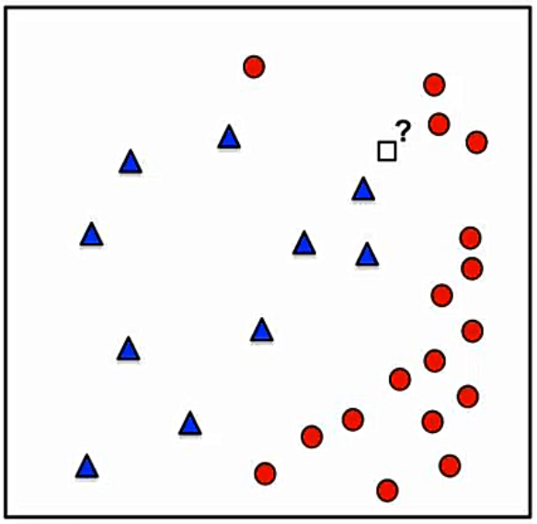
Example
What about this?
Use the intuition to classify new point (box point)
Find the most similar training data
It should be Blue (Triangle)

Slide 11
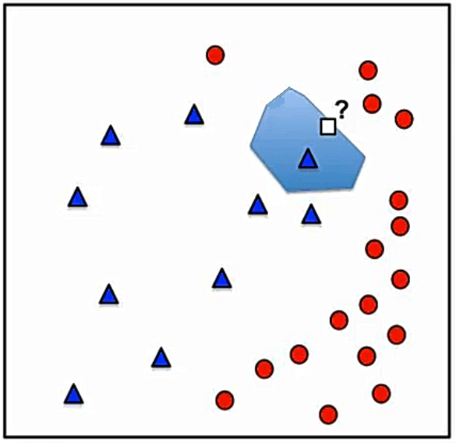
Example
What about this?
It is not just this point (box point) that is going to be blue
All of the points around the blue point are should be Blue (Triangle)

Slide 12
Example
It is called as voronoi
Voronoi Tesselation
Partition a space into non-overlapping regions
Generally, it contains a single point
Boundary : points at the same distance from two different training examples

Slide 13
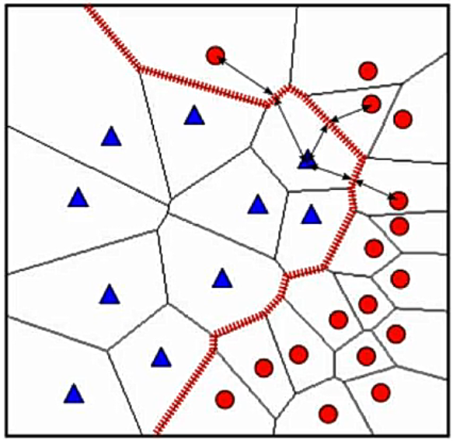
Example
Classification Boundary?
Non linear
Reflects classes well
Impresive for simple method

Slide 14
Nearest Neighboor Classification
Its Drawbacks

Slide 15
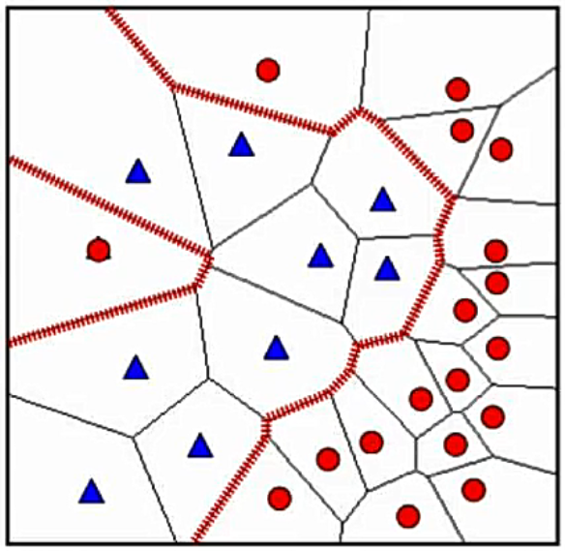
Nearest Neighboor : Outliers
If we change a single blue point as red point (which is subsequently called as outlier data)
The decision or classification boundary dramatically changes

Slide 16
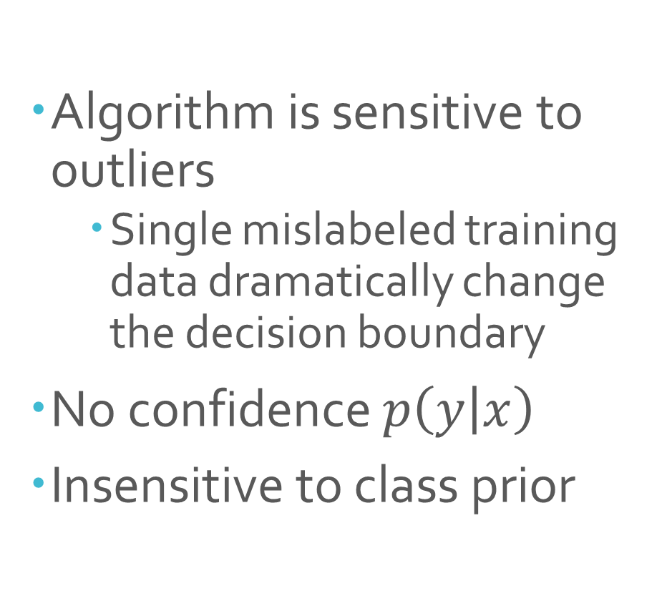
Drawbacks
Algorithm is sensitive to outliers
Single mislabeled training data dramatically change the decision boundary
No confidence $p\left(y | x\right)$
Insensitive to class prior

Slide 17
Sollution
To make this algorithm more sensitive to class prior
Idea :
Use more than one nearest neigboor to make decision
Count class labels in k most similar training data
By using more than one nearest neighboor, it makes the classifier more stable

Slide 18
k-Nearest Neighboor
Classification

Slide 19
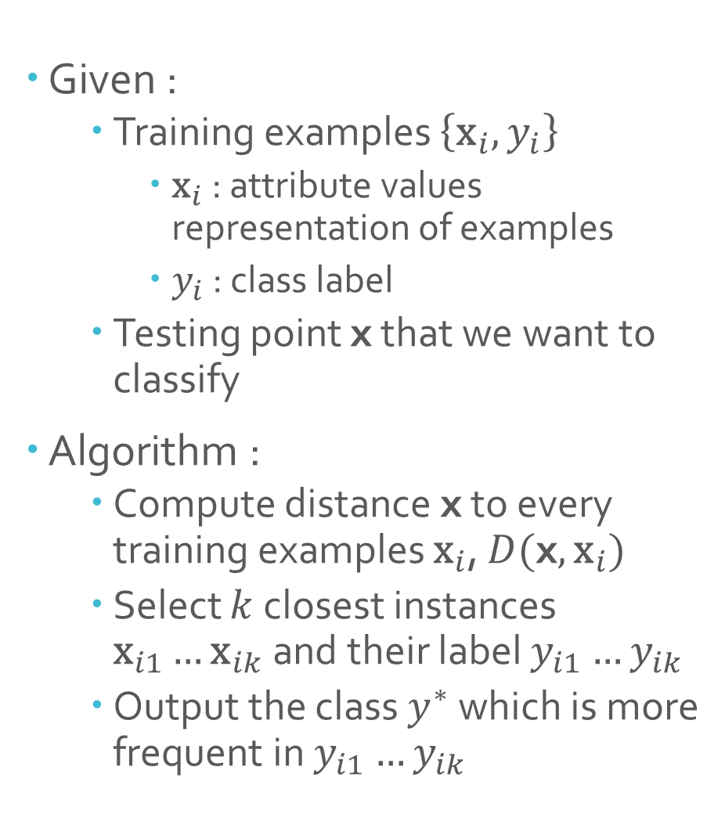
The Algorithm
Given :
Training examples $\left\{{\text{x}}_{i},y_{i}\right\}$
${\text{x}}_{i}$ : attribute values representation of examples
$y_{i}$ : class label
Testing point x that we want to classify
Algorithm :
Compute distance x to every training examples ${\text{x}}_{i}$, $D(\text{x},{\text{x}}_{i})$
Select $k$ closest instances ${\text{x}}_{i1}…{\text{x}}_{ik}$ and their label $y_{i1}…y_{ik}$
Output the class $y^{∗}$ which is more frequent in $y_{i1}…y_{ik}$

Slide 20
Distance Measures
Key component of the k-NN algorithm :
Defines which training examples are similar and which aren’t?
Can have strong effect on performance
Some distance measures:
Euclidean Distance
Minkowski Distance
Hamming Distance
Manhattan Distace
Mahalanobis Distance
dll

Slide 21
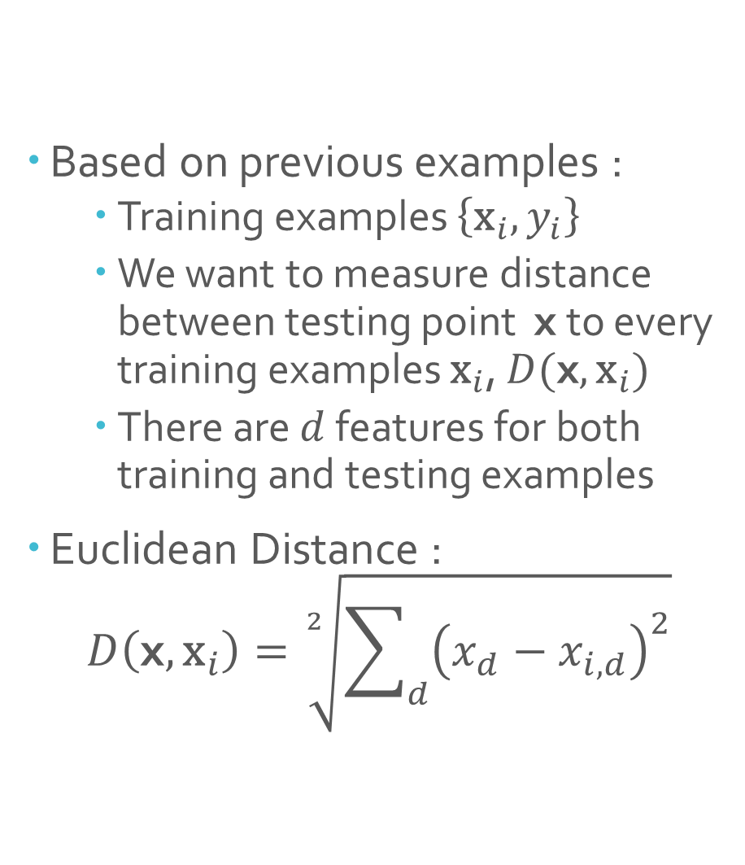
Euclidean Distance 1
Based on previous examples :
Training examples $\left\{{\text{x}}_{i},y_{i}\right\}$
We want to measure distance between testing point x to every training examples ${\text{x}}_{i}$, $D(\text{x},{\text{x}}_{i})$
There are $d$ features for both training and testing examples
Euclidean Distance :
$$D\left(\text{x},{\text{x}}_{i}\right)=\sqrt[2]{\sum_{d}{{\left(x_{d}−x_{i,d}\right)}^{2}}}$$

Slide 22
Euclidean Distancce Characteristics
Symmetric, Spherical, Threat all Dimension Equally
Sensitive to extreme differences in single attribute
Behaves like a “soft” logical OR

Slide 23
Euclidean Distance
Example

Slide 24
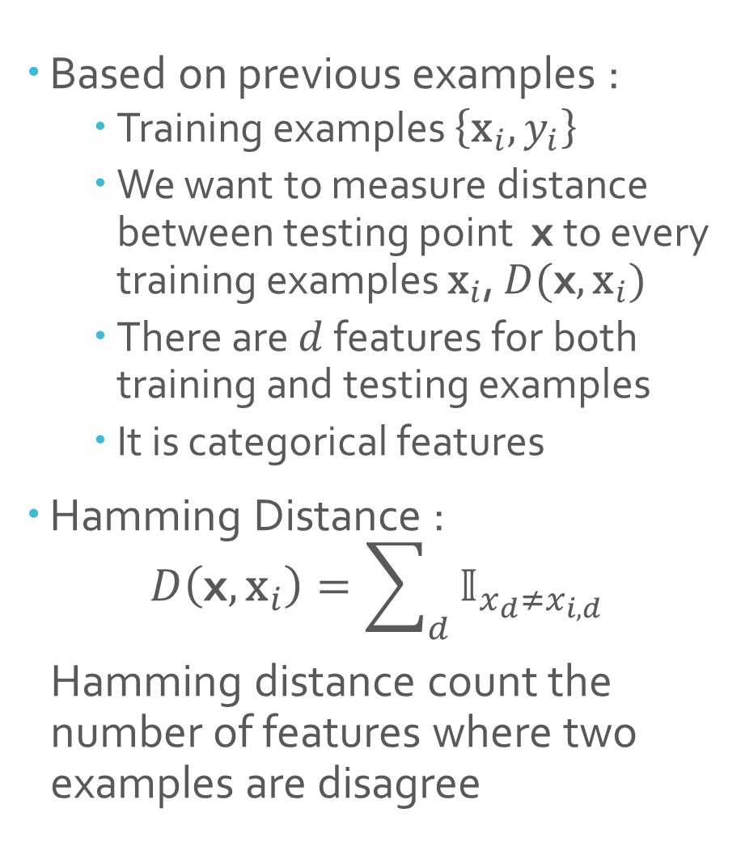
Hamming Distance 2
Based on previous examples :
Training examples $\left\{{\text{x}}_{i},y_{i}\right\}$
We want to measure distance between testing point x to every training examples ${\text{x}}_{i}$, $D(\text{x},{\text{x}}_{i})$
There are $d$ features for both training and testing examples
It is categorical features
Hamming Distance :
$$D\left(\text{x},{\text{x}}_{i}\right)=\sum_{d}{𝕀_{x_{d}≠x_{i,d}}}$$
Hamming distance count the number of features where two examples are disagree

Slide 25
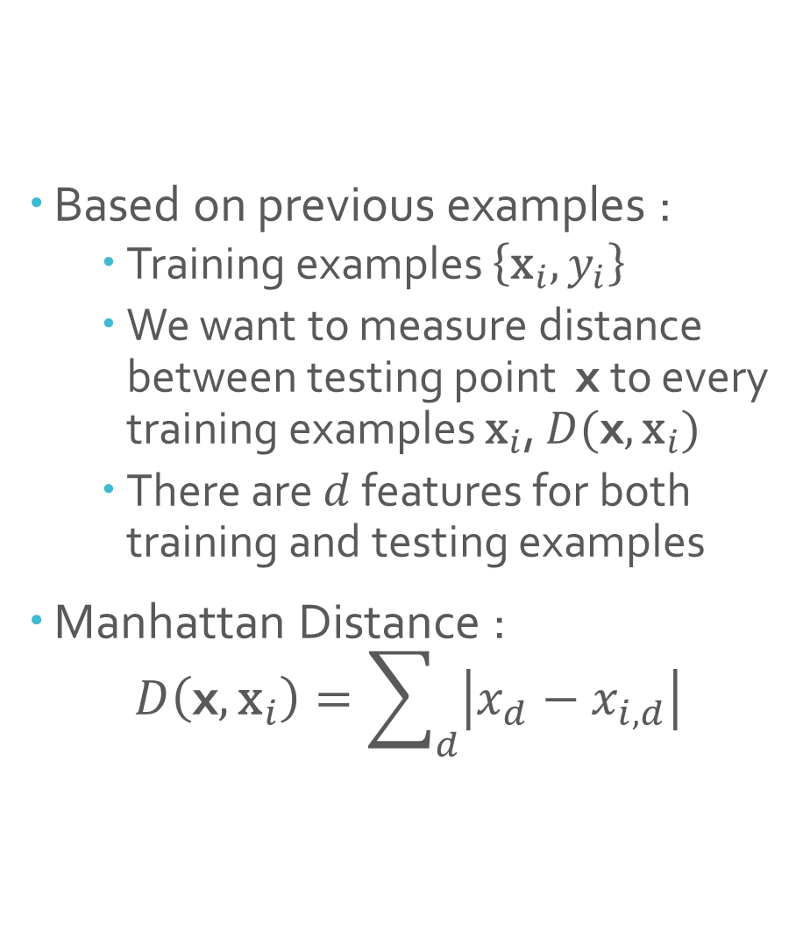
Manhattan / City Block Distance 3
Based on previous examples :
Training examples $\left\{{\text{x}}_{i},y_{i}\right\}$
We want to measure distance between testing point x to every training examples ${\text{x}}_{i}$, $D(\text{x},{\text{x}}_{i})$
There are $d$ features for both training and testing examples
Manhattan Distance :
$$D\left(\text{x},{\text{x}}_{i}\right)=\sum_{d}{\left|x_{d}−x_{i,d}\right|}$$

Slide 26
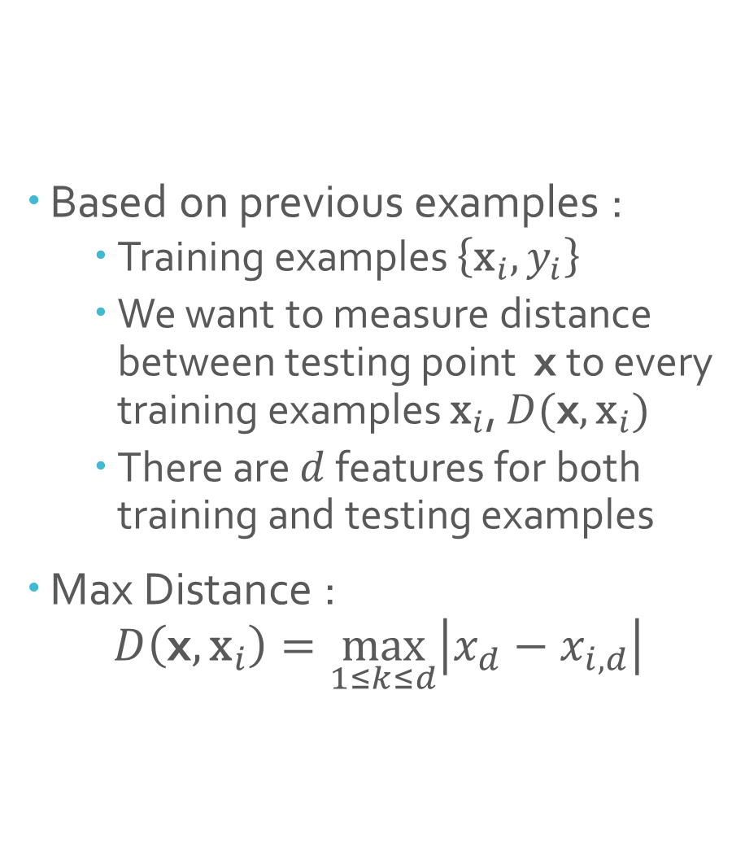
Max / Sup / Chebyshev Distance 4
Based on previous examples :
Training examples $\left\{{\text{x}}_{i},y_{i}\right\}$
We want to measure distance between testing point x to every training examples ${\text{x}}_{i}$, $D(\text{x},{\text{x}}_{i})$
There are $d$ features for both training and testing examples
Max Distance :
$$D\left(\text{x},{\text{x}}_{i}\right)=\max_{1≤k≤d}\left|x_{d}−x_{i,d}\right|$$

Slide 27
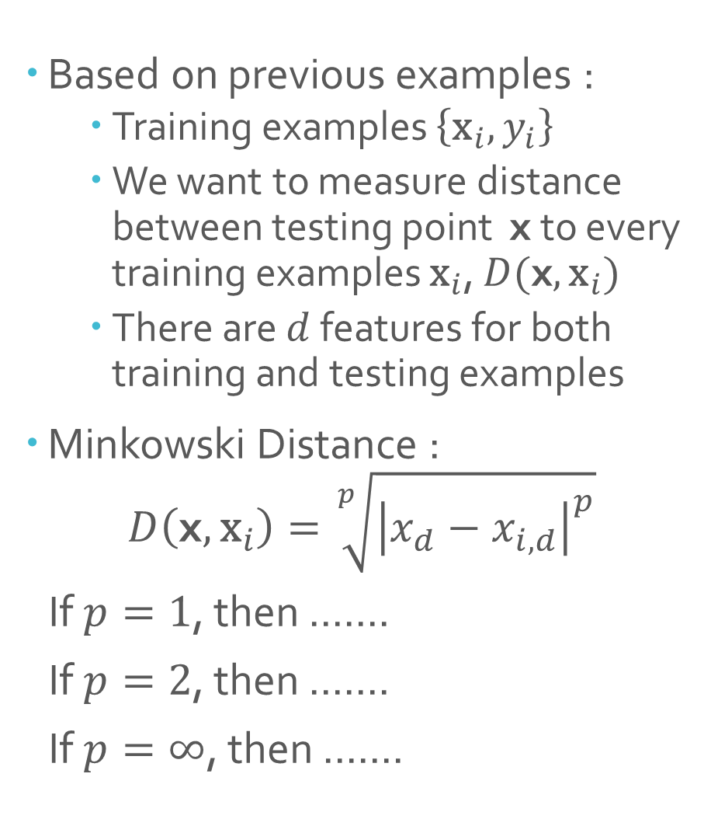
Minkowski Distance 5
Based on previous examples :
Training examples $\left\{{\text{x}}_{i},y_{i}\right\}$
We want to measure distance between testing point x to every training examples ${\text{x}}_{i}$, $D(\text{x},{\text{x}}_{i})$
There are $d$ features for both training and testing examples
Minkowski Distance :
$$D\left(\text{x},{\text{x}}_{i}\right)=\sqrt[p]{{\left|x_{d}−x_{i,d}\right|}^{p}}$$
If $p=1$, then .......
If $p=2$, then .......
If $p=∞$, then .......

Slide 28
Minkowski Distance

Slide 29
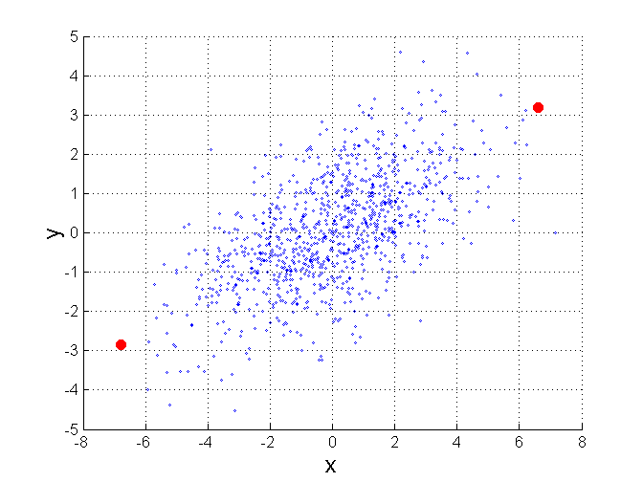

Mahalanobis Distance 6
$$mahalanobis\left(x,y\right)={ (x−y)}^{T}Ʃ^{−1}(x−y)$$
Σ is the covariance matrix
For red points, the Euclidean distance is 14.7, Mahalanobis distance is 6.
Notes:
X -> vector data, y -> mean

Slide 30
k-NN Classification
Example

Slide 31
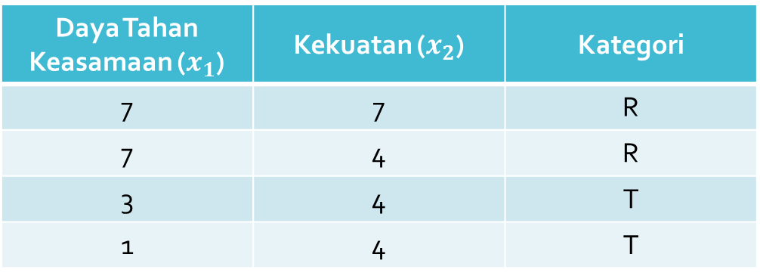
Contoh :
Hasil survey untuk mengkategorikan apakah sebuah kertas tissue termasuk kualitas tinggi atau rendah menunjukkan data sebagai berikut :
Sebuah pabrik memproduksi kertas tissue baru dan memiliki nilai daya tahan keasaman sebesar 3 serta kekuatan 7. Tentukan kategori dari tissue tersebut menggunakan algoritma KNN
Daya Tahan Keasamaan ($x_{1}$) | Kekuatan ($x_{2}$) | Kategori
7 | 7 | R
7 | 4 | R
3 | 4 | T
1 | 4 | T

Slide 32
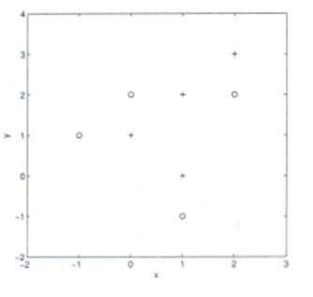
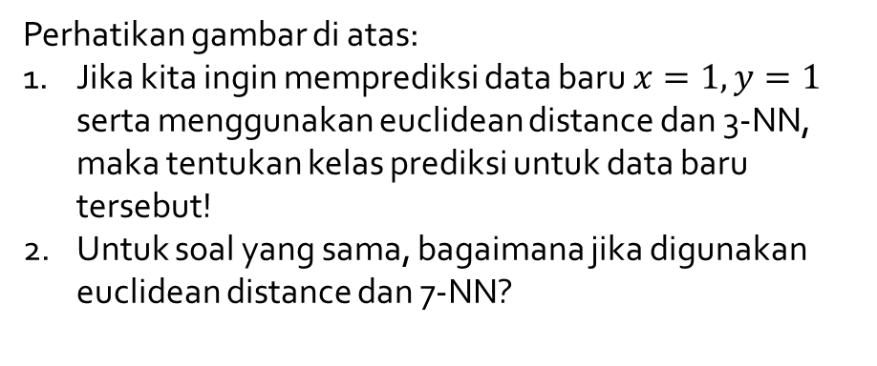
Soal
Perhatikan gambar di atas:
Jika kita ingin memprediksi data baru $x=1, y=1$ serta menggunakan euclidean distance dan 3-NN, maka tentukan kelas prediksi untuk data baru tersebut!
Untuk soal yang sama, bagaimana jika digunakan euclidean distance dan 7-NN?

Slide 33
k-NN Practical Issues

Slide 34
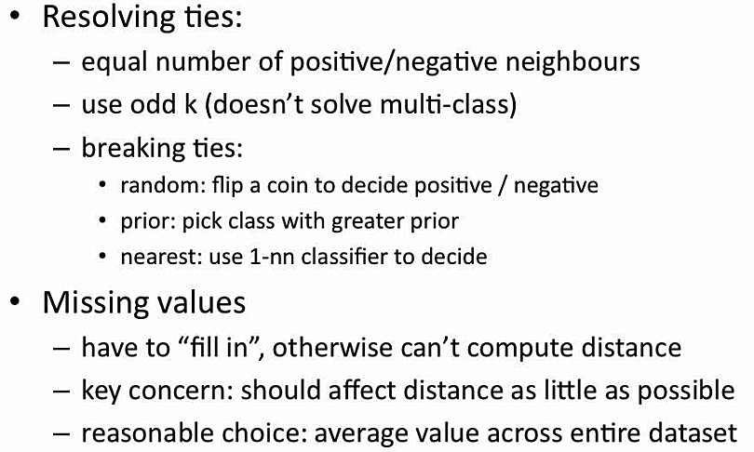

Slide 35
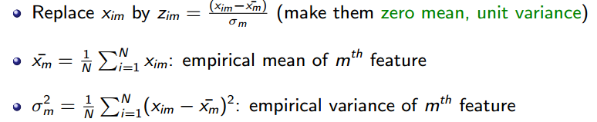
KNN Feature Normalization
Features should be on the same scale
Example:
If one feature has its values in millimeters and another has in centimeters, we would need to normalize
One way is:

Slide 36
Choosing the Value of k

Slide 37
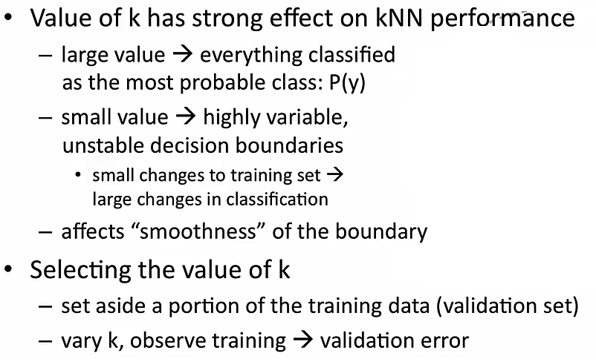
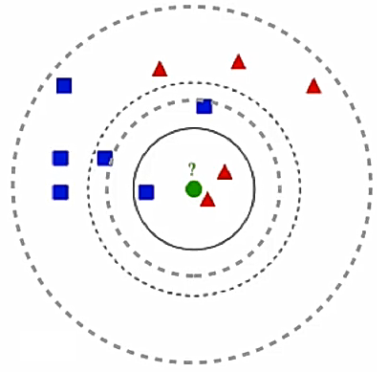

Slide 38
Making k-NN Fast

Slide 39
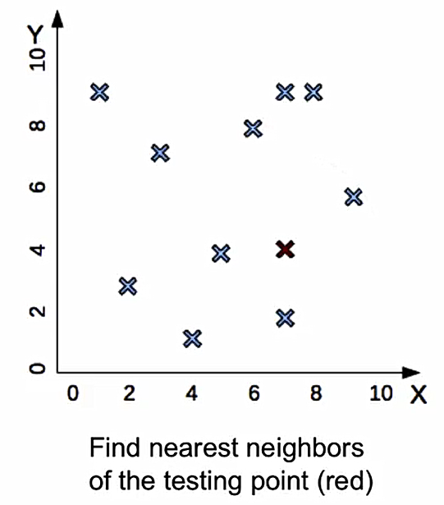
What You See
What Algorithm Sees

Slide 40
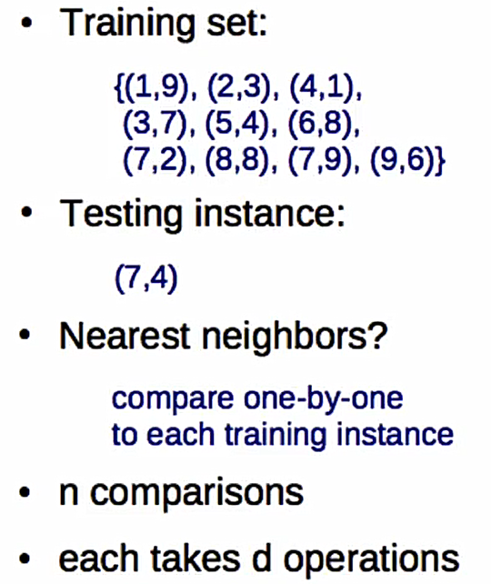
What You See
What Algorithm Sees

Slide 41
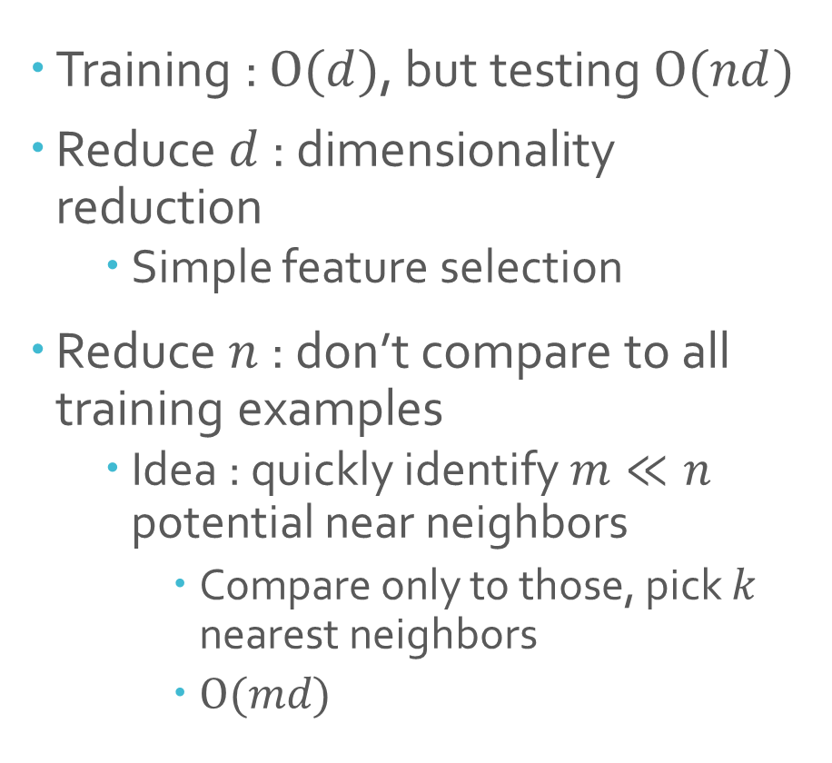
Training : $Ο(d)$, but testing $Ο(nd)$
Reduce $d$ : dimensionality reduction
Simple feature selection
Reduce $n$ : don’t compare to all training examples
Idea : quickly identify $m≪n$ potential near neighbors
Compare only to those, pick $k$ nearest neighbors
$Ο(md)$

Slide 42
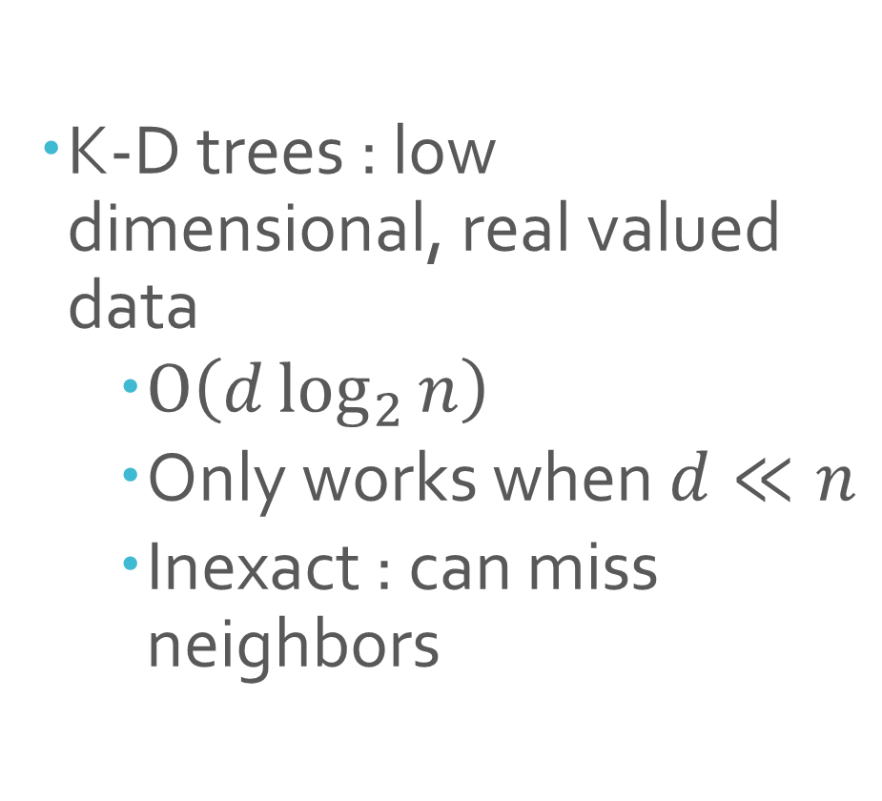

Example of Reduce $n$
K-D trees : low dimensional, real valued data
$Ο\left(d\log_{2}{n}\right)$
Only works when $d≪n$
Inexact : can miss neighbors

Slide 43
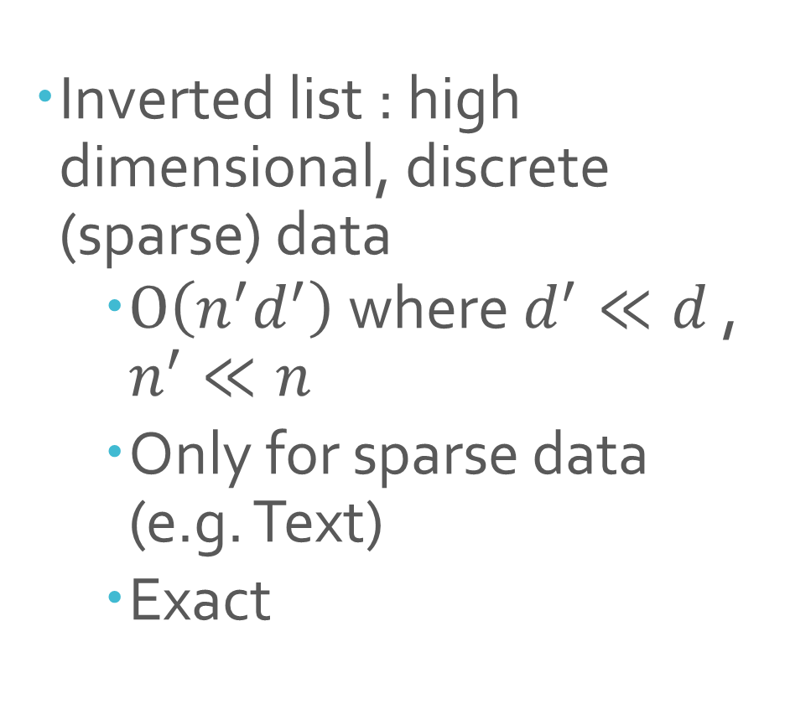
Example of Reduce $n$
Inverted list : high dimensional, discrete (sparse) data
$Ο\left(n^{′}d^{′}\right)$ where $d^{′}≪d$ , $n^{′}≪n$
Only for sparse data (e.g. Text)
Exact

Slide 44
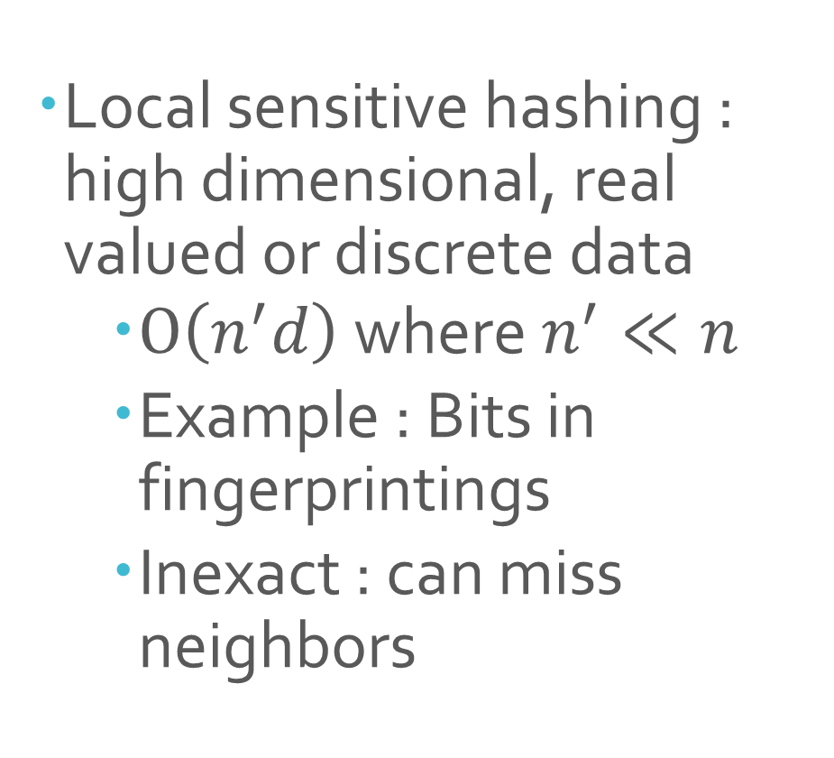
Example of Reduce $n$
Local sensitive hashing : high dimensional, real valued or discrete data
$Ο\left(n^{′}d\right)$ where $n^{′}≪n$
Example : Bits in fingerprintings
Inexact : can miss neighbors

